Slide 1
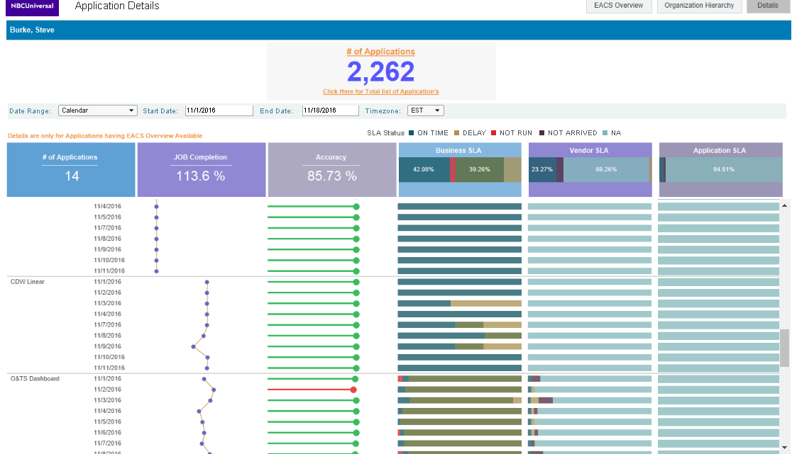
EACS Dashboard – Application Detail

